Slide 1

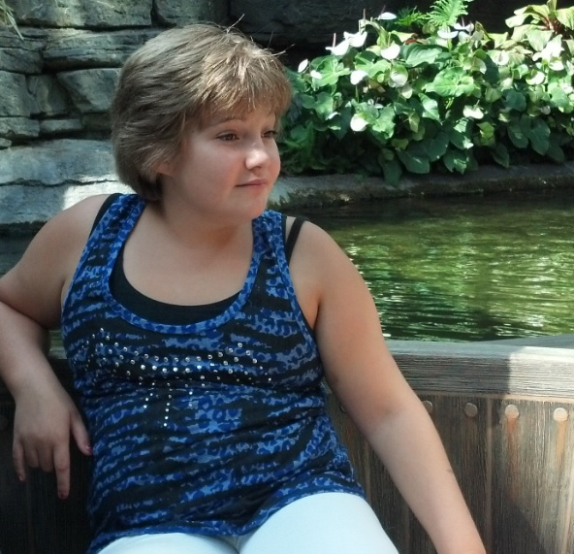
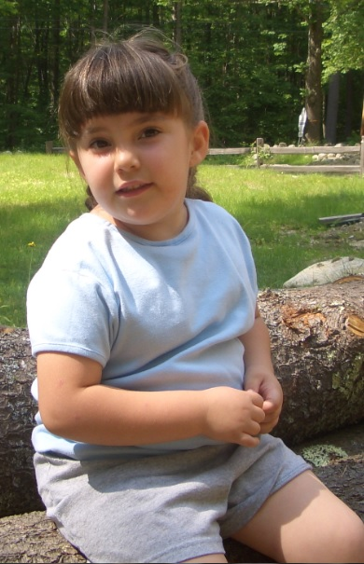
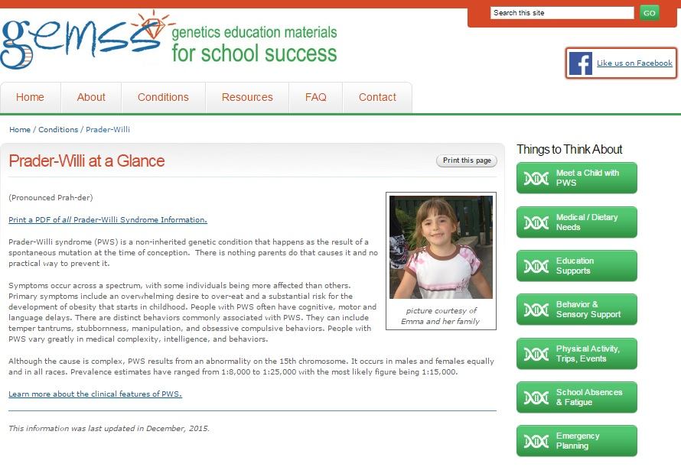
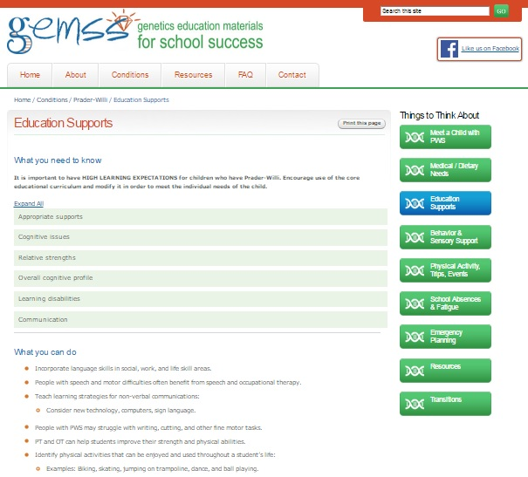
GEMSS - Genetics Education Materials for School Success: Prader-Willi Syndrome
www.gemssforschools.org
The AIM of GEMSS
To assure all children with genetic health conditions:
Succeed in school-life
Are members of neighborhood schools across the country
GEMSS is for Teachers, Parents,
School Nurses, and Genetic Counselors
Teachers and parents:
Use GEMSS to better understand the needs of students who have genetic conditions
Explore GEMSS to see if there are strategies you can implement
Share the link with other families and groups
Nurses/Genetic Counselors:
Refer families and educators to this site
Provide feedback on new conditions and suggestions to the GEMSS team
Provide printable handouts and flyers in your office waiting areas for families
GEMSS is a web based resource
for families and school personnel that offers:
  Genetic conditions explained in plain language
  Helpful strategies for field trips, diet, communication, instruction, transition, and more
  General tips and strategies for other conditions and undiagnosed
25+ Conditions in GEMSS
including…
Angelman | Prader-Willi
Cornelia de Lange | Rhett
Cystic Fibrosis | Sickle Cell
Down Syndrome | Turner
Fragile X | Urea Cycle
Fetal Alcohol | MCAD & VLCAD
Klinefelter | Williams
Marfan | 22q Deletion
Neuromuscular | More!
To find the GEMSS website, go to www.gemssforschools.org
Now available on your mobile device!
Parent Ambassadors
are invited to help us
spread the word!
GEMSS was created by geneticists, genetic counselors, teachers and parents as part of the New England Genetics Collaborative.

